Slide 1
An Inside Look at an Agile Transformation-Elevating Your Skills
Project Management in Practice-BU 2015

Slide 2
Your Journey Today is About

Slide 3
And….

Slide 4
Areas We Will Cover
My experience
The current state of Project Management (PM)
What is this thing called agile?
Can PM and agile ever coexist ?
An inside look at the SunGard (SG) transformation
What have we learned at SG
The new agile PM (skills, tools, how to make the jump)
Conclusion/Support and follow up

Slide 5
You at the End of Today
Evaluate the landscape
Learn from hearing about the SG transformation
Learn about the skills you need to elevate and how
Evaluate your current situation vs. the skills you will need
Establish a concrete action plan to gain the needed skills and how you will apply them
Network and leverage the support mechanism

Slide 6
My Experience
Jim Hannon PMP, MBA, PM-RMP, PM-ACP, CSM, CSP,CSPO (PhD student)
Over 20 + years experience (software, financial, consulting with the govt.)
Adjunct faculty and instructor
Frequent speaker at PMI and other industry events

Slide 7
The Current State of PM and PMOs
PMs and Project Management Offices (PMO) are still seen as a cost center
PMs need to be more hands on-lead the teams
The good PM offers leadership, motivates , helps solve problems (impediments –remember this for later) and makes things happen
The bad PM is deemed an admin person not a key member of the team
Program and portfolio management is still misunderstood
Overall we give value, but we need to deliver more and get a full seat at the table !!

Slide 8
Some Data to Consider
The Project Management Institute’s Pulse of the Profession is a global research study in 2014 the results show that in order to remain competitive, organizations must tie projects to strategy and place a primary focus on people, processes, and outcomes.
PMI’s Pulse research reveals the reason: just 42 percent of organizations report having high alignment of projects to organizational strategy. Furthermore, only 32 percent of organizations report that their projects are better aligned compared with those of a year ago.
Read more at http://www.business2community.com/strategy/state-project-management-2014-01028542#00rluUq9aqgLVKUD.99

Slide 9
Interactive Exercise #1

Slide 10
Increased Consumer Expectations
As consumers today we want and expect innovative products: faster, cheaper and with better quality than those we’ve seen in the past.
Consumer Expectations

Slide 11
Increased Work Pressure
As knowledge workers, our business tools have improved our capability to be productive, raising work expectations.
Business Expectations

Slide 12
What is This Thing Called Agile?

Slide 13
History of Agile & Lean
Evolution
Early 1990s
Crystal Methods
Lean Software Development
Dynamic Software Development Method (DSDM)
Mid 1990s
Feature Driven Development (FDD)
eXtreme Programming (XP)
Adaptive Software Development
2001: Manifesto for Agile Software Development
http://www.agilemanifesto.org
2005: Declaration of Interdependence
http://www.pmdoi.org/
History & Influences
Early 1900s
Walter Shewhart: Plan-Do-Study-Act, SPC
Mid 1900s
Edward Deming: SPC, TQM
Toyota: Toyota Production System (TPS)
Peter Drucker: Knowledge Worker
Late 1900s
Womack and Jones: Lean Thinking
Eli Goldratt: Theory of Constraints
Tom Gilb: Evo
The Toyota Way

Slide 14
Key Agile Principles
Key Agile principles are:
Focus on Customer Value – Align project, product and team visions to deliver better product quality – faster and cheaper.
Small Batches - Create a flow of value to customers by “chunking” feature delivery into small increments.
Small, Integrated Teams - Intense collaboration via face-to-face communication, collocation, etc; diversified roles on integrated, self-organizing, self-disciplined teams.
Small, Continuous Improvements – Teams reflect, learn and adapt to change; work informs the plan.
Delivering Customer Value with Agile Project Management
The right product, at the right time, for the right price.
Higher Quality: “Designed-to-fit” product with flexibility to change.
Increased Throughput: Iterative and incremental project and product “chunks” with earlier value delivery.
Reduced Waste: Lean, efficient processes with lower costs and higher productivity.

Slide 15
Scrum has been used by:
Microsoft
Yahoo
Google
Electronic Arts
High Moon Studios
Lockheed Martin
Philips
Siemens
Nokia
Capital One
BBC
Intuit
Intuit
Nielsen Media
First American Real Estate
BMC Software
Ipswitch
John Deere
Lexis Nexis
Sabre
Salesforce.com
Time Warner
Turner Broadcasting
Oce
Nelsen Media
First American Real Estate
BMC Software
Ipswitch
John Deere
Lexis Nexis
Sabre
Salesforce.com
Time Warner
Turner Broadcasting
Oce
SunGard

Slide 16
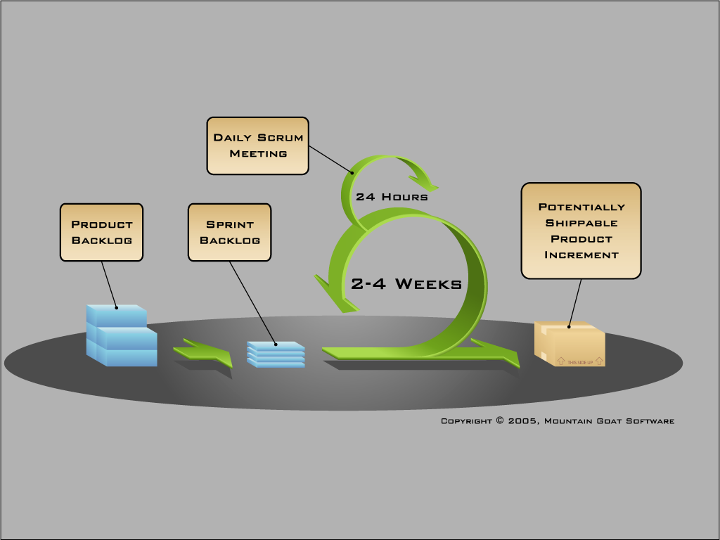
Key Agile Practices
Key Agile Practices:
Release Planning
Sprint Planning
Daily Scrum/Standup
Fixed-length sprints
Sprint Review
Sprint Retrospective
Identify top-priority items and deliver them rapidly using:
Small batches
Small integrated teams
Small, continuous improvements
Notes:
Iterative development lifecycle:
Balance is important; JUST ENOUGH process to help people work most efficiently
Framework is important, but team is equally important, will address that shortly as well
Small releases mean MORE VISIBILITY, hence better ability to ADAPT QUICKLY
Reduces need for forecasting and guesswork
Reduces risk by limiting potential cost of mistakes
Feature reviews address product optimization, Process Reflections address process optimization
Highlight differences from waterfall lifecycle *
Short timeframes, high visibility
Complete features in small releases
Strong collaboration, complete teams
NEXT: Self-Organization Exercise

Slide 17
The Details on the Scrum Process

Slide 18
Scrum Master
Represents management to the project
Typically filled by a Project Manager or Team Leader
Responsible for enacting scrum values and practices
Main job is to remove impediments
The Scrum Team
Represents management to the project
Typically filled by a Project Manager or Team Leader
Responsible for enacting scrum values and practices
Main job is to remove impediments
Product Owner
Acts like one voice (in any case)
Knows what needs to be built and in what sequence this should be done
Typically a product manager

Slide 19
Sprint Planning Meeting
A collaborative meeting in the beginning of each Sprint between the Product Owner, the Scrum Master and the Team
Takes 8 hours and consists of 2 parts (“before lunch and after lunch”)
1st Part:
Creating Product Backlog
Determining the Sprint Goal
Participants: Product Owner, Scrum Master, Scrum Team
2nd Part:
Participants: Scrum Master, Scrum Team
Creating Sprint Backlog

Slide 20
Sprint
A 2-4 week iteration, during which is incremented a product functionality
NO outside influence can interfer with the Scrum team during the Sprint
Each Sprint begins with the Daily Scrum Meeting
Daily Call
Is a short (15 minutes long) meeting, which is held every day before the Team starts working
Participants: Scrum Master (which is the chairman), Scrum Team
“Chickens” and “Pigs”
Every Team member should answer 3 questions
What did you do since the last Scrum?
What are you doing until the next Scrum?
What is stopping you from getting on with the work?

Slide 21
Sprint Review Meeting
Is held at the end of each Sprint
Business functionality which was created during the Sprint is demonstrated to the Product Owner
Informal, should not distract Team members from doing their work

Slide 22
Product Backlog
Requirements for a system, expressed as a prioritized list of Backlog Items
Is managed and owned by a Product Owner
Spreadsheet (typically)
Usually is created during the Sprint Planning Meeting
Can be changed and re-prioritized before each PM

Slide 23
Estimation of Product Backlog Items
Establishes team’s velocity (how much Effort a Team can handle in one Sprint)
Determining units of complexity
Size-category (“T-Shirt size”)
Story points
Work days/work hours
Methods of estimation:
Expert Review
Creating a Work Breakdown Structure (WBS)

Slide 24
Some Data to Consider
Waterfall
GOCC-6985 – 396 days
GOCC-7967 – 217 days
GOCC-7532 – 180 days
Total days 791 days – 1 developer, 2 testers, 1 developer (acting as a tester)
Agile
Epic GOCC- 8957 – consisting of 52 story’s
Total days 164 days (this includes time until the end of the current sprint – 14th May) – 2 developers, 1 part time tester (came in 2/3 of the way through)
I have the breakdown of the figures but the waterfall times includes time for ‘Development on hold’ and the fact that the issues were sat in ‘Testing Check in’ until the testing backlog sprint was created.
One of the advantages of Agile is that the development and testing are performed at the same time within the Sprint so hopefully with the closer collaboration the quality will be higher as well.

Slide 25
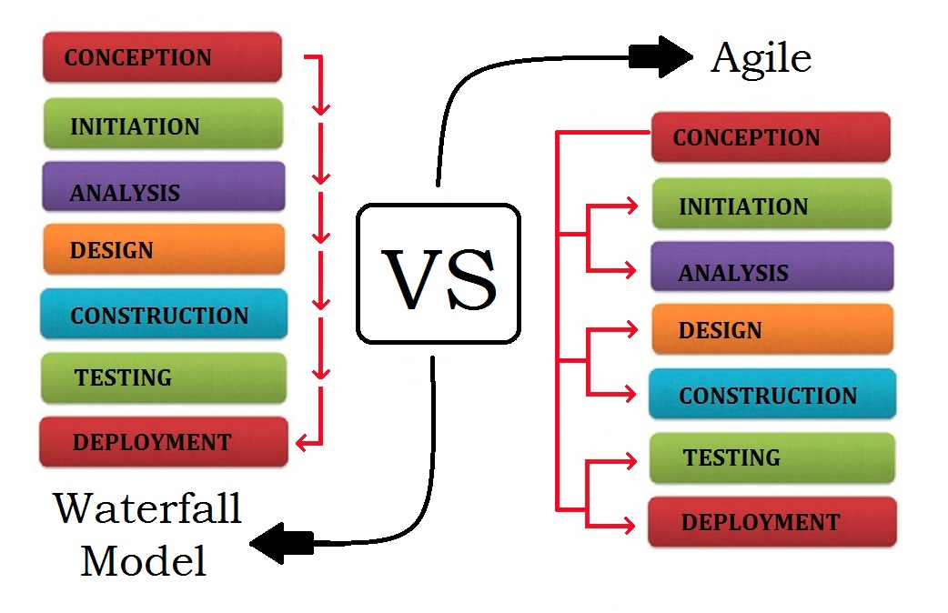
Waterfall vs. Agile

Slide 26
Interactive Exercise #2

Slide 27
Can PM and Agile Coexist?

Slide 28
Transitioning to Agile PM
While many traditional project management skills translate to APM, some transitions are necessary:
Agile Project Management | Traditional Project Management
Focus on customer satisfaction and interaction | Focus on plans and artifacts
Response to change via adaptive action | Change controlled via corrective action
Progressive elaboration, rolling-wave planning | Monumental up-front planning
Customer prioritized, time-boxed delivery | Manager negotiated, scope-based delivery
Commitment management via feature breakdown structure | Activity management via work breakdown structure
Collaboration on self-disciplined and self-organizing teams | Top-down control
Minimal set of context-sensitive, generative practices | Prescriptive, heavyweight methods
Essential, value-focused metrics | Non-value added controls
Notes:
This represents a way of thinking (an “Agile” mindset)
Scrum is a management process that gives us the opportunity to practice and develop these Agile values.

Slide 29
Flexible Formal Structure
Traditional Silos
Product
Owner
PM
BA
Designer
Developer
Tester
Release
Manager
Integrated Agile Team
The Core Project Team ideally consists of 5-9 (7 plus or minus 2) members.
Architect
Capacity
Planner
Core Project
Team
BA
Designer
BA
Extended
Project Team
DBA
Developer
PM
Prod.
Developer
Tester
Product
Owner
Tech
Ops
Security
Business
Sponsor

Slide 30
Organic Teams
Objectives:
Structure and build self-organizing agile teams based on an organic CAS model
Integrate them effectively into the larger enterprise
Key Implications:
View agile teams as organic CAS
Recognize the difference between formal and informal team structures and structure agile teams accordingly
Mold groups of individuals into high-performance agile teams
Integrate these teams into the larger agile enterprise
“Skillful managers understand the interdependence between design and emergence. They know that in today’s turbulent business environment, their challenge is to find the right balance between the creativity of emergence and the stability of design.”
Fritjof Capra, The Hidden Connections

Slide 31
Encourage Diversified Roles
Define roles holistically so that team members can develop into Generalizing Specialists (or Versatilists):
“Generalizing Specialist” Someone with one or more specialties who actively seeks to gain new skills in existing specialties, as well as in other areas.
A generalizing specialist is more than just a generalist. A generalist is a jack-of-all-trades but a master of none, whereas a generalizing specialist is a jack-of-all-trades and master of a few”
Scott Ambler
Notes:
In my work, I pay special attention to financial services, and have quite a bit of knowledge of the domain. I find it helps me do better with my clients, and also deliver better solutions in general.
Question: How can you be a generalizing specialist?
NEXT: Example Team Structure

Slide 32
Guiding Vision
Objective:
Create a shared vision or mental model for driving behavior on agile projects. The Guiding Vision is an aggregate of three component visions: team vision, project vision and product vision
Key Implications:
Evolve team vision to drive team behavior
Create project vision to drive project behavior
Facilitate product vision to drive project evolution
A shared vision is not an idea… it is, rather, a force in people’s hearts, a force of impressive power.
Peter Senge, The Fifth Discipline

Slide 33
Inside The SG Transformation
Notes:
In my work, I pay special attention to financial services, and have quite a bit of knowledge of the domain. I find it helps me do better with my clients, and also deliver better solutions in general.
Question: How can you be a generalizing specialist?
NEXT: Example Team Structure

Slide 34
The SG Business
SunGard is one of the world’s leading software and technology services companies, with annual revenue of about $2.8 billion. SunGard provides software and processing solutions for financial services, education and the public sector. SunGard serves over 15,000 customers in more than 100 countries and has approximately 13,000 employees.

Slide 35
Introduction
Why SunGard cannot continue as before
Customers need us to help them take advantage of every major market trend, opportunity, and transformation
People want products constantly updated with new apps and functionality
This high expectation is spreading to enterprise applications
Traditional methods not focusing enough on creating value
Why did Sungard have to change so much to stay competitive?
It is not just about putting out code more frequently. We must increase quality as well. To get it right requires new thinking, a new approach
A QA team could not maintain its current test plans if the build cadence suddenly increases
Developers need immediate feedback on where code is not working, or there will not be time to fix it
Product management must work closer with the development teams and customers on changing priorities

Slide 36
Introduction
Why did SunGard embrace Iterative Methodologies?
Build the right software and building it right
Increase quality
Increase consistency across product groups
Reuse and share work done across teams and groups
Reduce tool complexity
Empower staff to get more innovation and ideas into products
Ultimately get product out the door quicker

Slide 37
The Process
Standard “cookbook” guiding the team through the process
• The team contacts group CTO and they contact iterative group
• Iterative group will describe the transformation process to group
• The senior leaders of the team go through training
• We ask the senior leader to give support and announce in an email; The transformation is starting!
• We guide in the process of selecting Scrum Masters and the makeup of the teams
• The management picks a real project for the pilot. That team gets a second round of training
• An internal scrum coach walks through all the activities in the pilot, then works with the group and also does a full group level training
• The coach works with the team on the live date for the group and schedules a three month check in

Slide 38
Where Are We?
We constantly communicate through multiple channels
We dive into the teams !!
10 groups are either in the process or done
We have a global virtual team of model groups, SME’s and coaches
We are on track to get a very high percentage of teams done by year end
Clients are expressing strong interest-want to learn more
The following words are now being heard in all areas of the company

Slide 39
What We Have Learned?
All people want to ride on the success train
This is not easy but the benefits make the work worthwhile
People are afraid of change , so confront it early and often . Sometimes you still can not convince them so SHOW it works
Most times people know the process does not work but really do not know how to fix it
Get and affirm at each chance senior management support at each chance
Communicate and then communicate again
The scrum masters need to be fanatical –they are the tip of the sword
You and the team will reach a roadblock, confront it, solve it or decide to go around
Preach the concept of done !!

Slide 40
Is This the New Agile PM ?

Slide 41
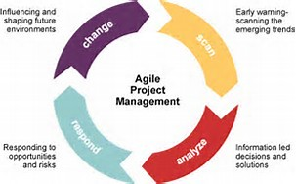
An Overview of the New Agile PM

Slide 42
The New Agile PM
Project professionals must first develop a firm understanding of agile — and be willing to adjust.
“Many classically trained project managers feel unnerved when dealing with the lack of prescription in agile projects,” says Simon Robertson, PMP, principal project manager and trainer of Robertson Consulting, Stockbridge, United Kingdom. “They find themselves fighting to be in control instead of embracing the constantly changing environment.”
An agile approach requires a different project management mindset, he says.
As such, agile-minded project managers must work with the team and stakeholders to foster shared understanding of the expected ROI. They must also help the team quickly identify its tasks to ensure business outcomes are being realized.

Slide 43
The New Agile PM
To gain exposure to skills that will help you work best in an agile environment, pursue projects being implemented using the approach. Sharing your experience with colleagues is another effective way to position yourself as an agile expert.
“Present a case study at local PMI chapters,” Mr. Griffiths says. “If a hiring manager sees that you’ve presented a case study or written a paper on the topic, it demonstrates your ongoing commitment to learning and education.”

Slide 44
Skills for the New Agile PM
Strong interpersonal skills including mentoring, coaching, collaborating, and team building
Strong analytical, planning, and organizational skills with an ability to manage competing demands
Strong knowledge and understanding of business needs with the ability to establish/maintain high level of customer trust and confidence
Proven ability to lead software development projects and ensure objectives, goals, and commitments are met
Solid understanding of and demonstrated experience in using appropriate tools:

Slide 45
Skills for the New Agile PM (cont)
Agile Project Management tools such as Jira/Greenhopper, Rally, VersionOne or equivalent
Microsoft Project, Visio, and all Office Tools
Excellent oral and written communications skills and experience interacting with both business and IT individuals at all levels including the executive level
Creative approach to problem-solving with the ability to focus on details while maintaining the “big picture” view

Slide 46
The PMO and Agile
Develop a training program. Provide coaching.
Select and train coaches.
Challenge existing behaviors.
Assist with reporting.
Assist with compliance needs.
Manage the inflow of new projects.
Assist in establishing and collecting metrics.
Reduce waste.
Help establish and support communities of practice.
Create an appropriate amount of consistency across teams.
Provide and maintain tools.
Coordinate teams. Work with other groups

Slide 47
Interactive Exercise #3

Slide 48
Conclusion
What have we learned ?
List five actions items on the following web page www.thebentleygroupintl.com and update everyone on your status
Reach out to the same web page for a free 90 day support
Lets review our questions
Evaluate the landscape
Learn from hearing about the SG transformation
Learn about the skills you need to elevate and how
Evaluate your current situation vs. the skills you will need
Establish a concrete action plan to gain the needed skills and how you will apply them
Network and leverage the support mechanism

Slide 49
References
Lithespeed Presentation on Agile Project Management Augistine
Project Management Institute
www.Mountaingoatsoftware.com

